Slide 1
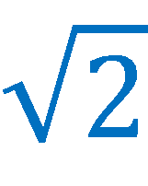
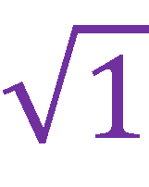
You, π, are completely irrational!
Defining rational and irrational numbers

Slide 2
Real Numbers
What do you remember about the following types of numbers?
Whole numbers
Integers
Rational numbers
Tell me as much as you can about these!

Slide 3
Real Numbers
Whole numbers: 0, 1, 2, 3, 4…
We might call these the counting numbers.
Integers: …, -3, -2, -1, 0, 1, 2, 3…
The counting numbers and their opposites (negatives).

Slide 4
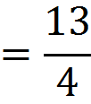
Real Numbers
Rational numbers
Any number that can be written as a ratio of integers in the form of
Rational!
Rational!
Rational!

Slide 5
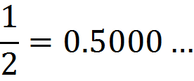
Real Numbers
Previously we discovered another definition of rational numbers. What is it? Use the following examples to help you.
Rational numbers repeat!

Slide 6
Real Numbers
So far, we have this picture of how numbers fit together:
Rational Numbers
But there’s a bigger picture!
Integers
Whole Numbers

Slide 7
Real Numbers
Are there decimals that don’t eventually repeat a pattern?
No repeating pattern!
No repeating pattern!
No repeating pattern!
Why is this not a repeating pattern?
Discuss this with a partner, then share with the class what you think.

Slide 8
Real Numbers
Since numbers that eventually have a repeating pattern of digits when written as a decimal are called rational, we call numbers that don’t eventually have a repeating pattern of digits irrational numbers.

Slide 9
Real Numbers
Now we have new picture:
Rational Numbers
Irrational Numbers
Integers
Whole Numbers

Slide 10
Real Numbers
And together they make: THE REAL NUMBERS!
Real Numbers
Rational Numbers
Irrational Numbers
Integers
Whole Numbers

Slide 11
Irrational Numbers
Where do irrational numbers most often occur? Discuss the following numbers with a partner and decide if they are rational or irrational. You may use a calculator if you would like.
Make sure you can explain why you think so!

Slide 12
Irrational Numbers
Rational or irrational? Why?
Irrational!
Rational!
Rational!
Irrational!
Rational!
Rational!

Slide 13
Irrational Numbers
Would a calculator help us identify these? Why or why not?
Notes:
While you could punch in the square root of 7 or convert the fraction 11/7 to decimal through division on a calculator, these don’t bring us any closer to knowing whether it is rational or irrational because we can’t see the full decimal expansion.

Slide 14
Irrational Numbers
With your partner, discuss what type of numbers are commonly irrational? Why?
Now share your thoughts with the class.
Are all numbers written with a square root symbol irrational?
Notes:
This slide should lead students to the idea that most square roots are irrational.

Slide 15
Irrational Numbers
Is the following number rational or irrational? Why?
What about this one?
What’s the difference between them?
Notes:
We often deal with positive irrational numbers, but they can just as easily be negative. Students should familiarize themselves with the concept of negative irrational numbers just as they did with negative rational numbers in previous grade levels.

Slide 16
Irrational Numbers
Now for bonus fun, ask about this number!

